Slide 1
Using Ag Data to Know What is Happening Region 16
Jessica Castañeda
Educational Consultant-Spark Innovations

Slide 2
What kind of agriculture is in your area?
Why do workers come to your area?
What kind of work are they doing?
What changes are happening in the region?
Are you aware of how agriculture continues to change in the Panhandle?
How do you work with growers/employers?
What is your strategy for recruiting OSY?

Slide 3
Feedlot Directories
https://www.cattlemaps.com/feedlot-directory/
https://www.angus.org/Commercial/Links/CommFeedlotRpt.aspx

Slide 4
Food Directory listings
https://www.ams.usda.gov/services/local-regional/food-directories-listings
Local food directory- farms- https://www.ams.usda.gov/local-food-directories/onfarm

Slide 5
USDA Atlas Maps
https://www.ers.usda.gov/data-products/food-environment-atlas/go-to-the-atlas/

Slide 6
Ag Census Web Maps
https://www.agcensus.usda.gov/Publications/2012/Online_Resources/Ag_Census_Web_Maps/index.php

Slide 7
New H2A Map- Farm Listings

Slide 8
Projected H2A 2017 reports

Slide 9
Icert Portal
Use this to keep up with new listings of H2A farms and the details of where workers will live, work and what they will be doing.
The numbers of H2a workers keep rising all over.

Slide 10
Crop Scape- Cropland Data Layer- USDA
View specific places and what crops are available by address
View summary reports of what a county or a region has.
View changes from one year to another in land use
Identify crops at the pixel

Slide 11
Farm Subsidy Database
Identify names of farmers who have received subsidies
Learn how they have changed
Search by state
See state statistics by crop area

Slide 12
MANTA- Business white pages

Slide 13
Google Maps
Use them to log in key farms
Keep data of visits on private maps
Use them as GPS out in the field to stay organized
Helpful when organizing recruiting efforts and sweeps
https://drive.google.com/open?id=1CUcFOPoUSC1R03O1vixWFPeAoUo&usp=sharing

Slide 14
Using Google Earth to view areas

Slide 15
Using Google to search about ag in your state
Don’t forget the power of a good search
If things are changing most likely there is an explanation in a local news report.
Worker numbers are changing nationwide. View the IRRC lit review to learn more.
View Powerpoint
Colorado- workers
LA- ag update

Slide 16
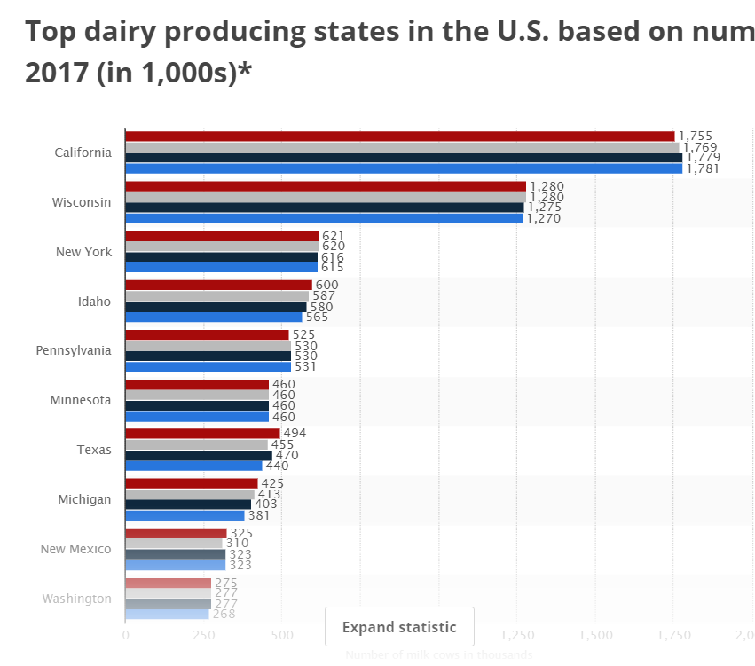
IRRC Ag Trends Resources- Dairy
http://www.idr-consortium.net/DairyTrends.html

Slide 17
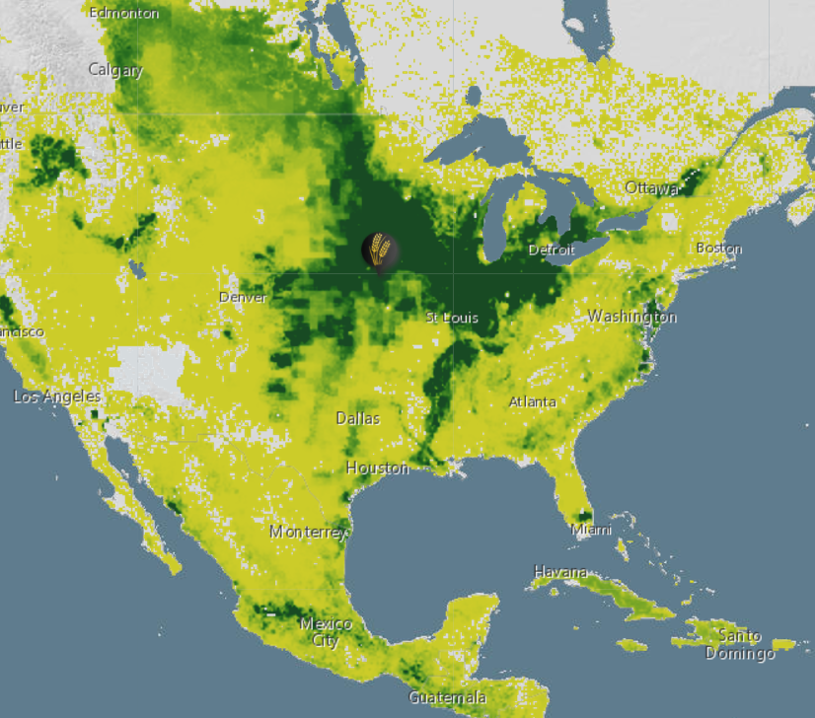
IRRC Ag Trends Resources- Petroleum and Water

Slide 18
IRRC Ag Trends- New Technologies

Slide 19
IRRC- State Profiles

Slide 20
Farm Plenty Local Crop Trends
Review top crops in a localized area.
View how the prices of the crops have grown and the percentage of the acres in an area.

Slide 21
Crop Trends
Maps of where specific things are grown across the country

Slide 22
Contact Information

